Slide 1

E.D.’s Report
Executive Director Kevin Delahoussaye
January – February 2026
Notes:
LHC is embarking on a new year filled with exciting new successes for Louisiana residents. Our first month of this new year is nothing short of excellent!

Slide 2
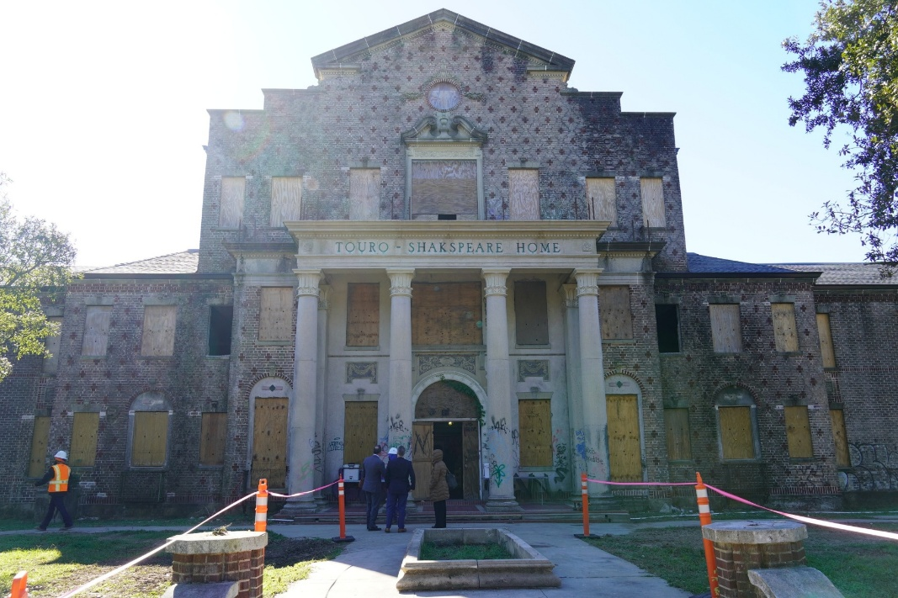
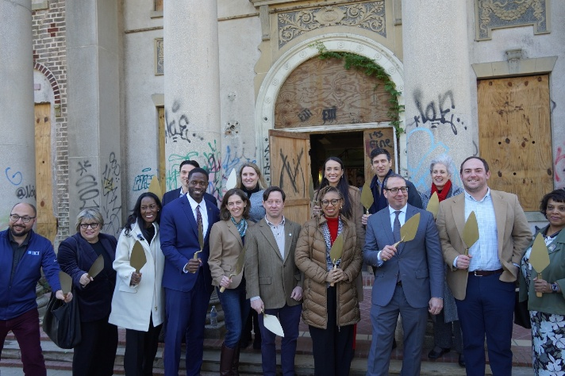
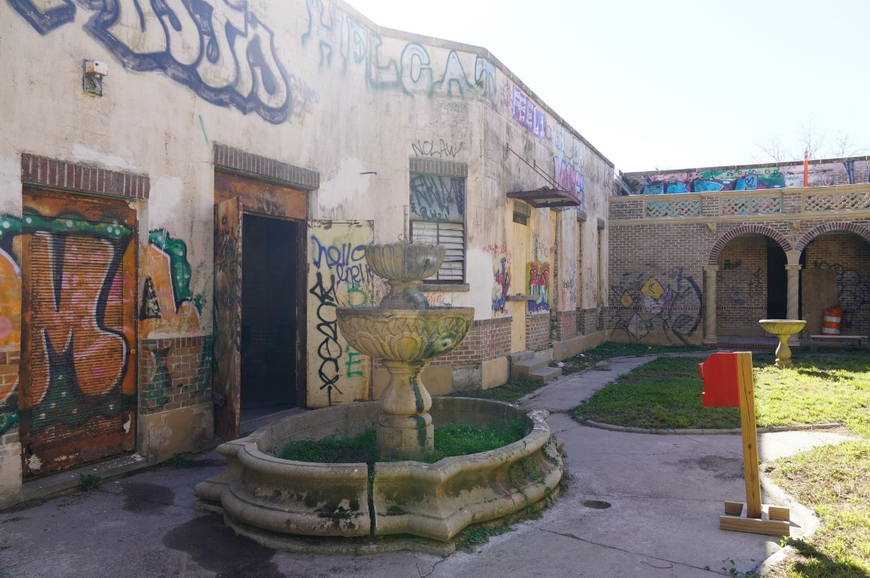
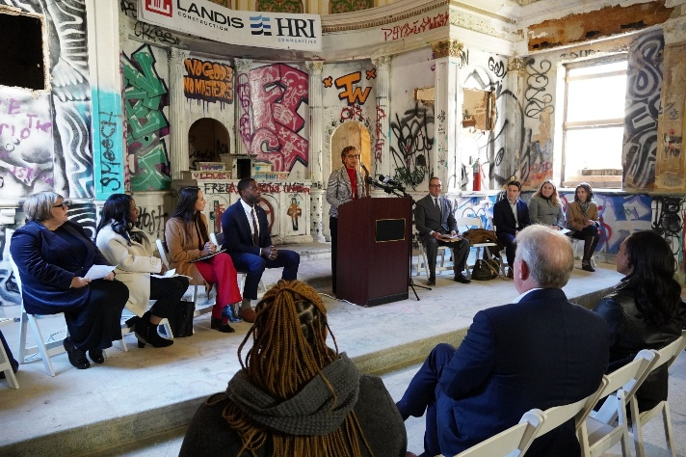
Groundbreaking of Touro Shakspeare
Notes:
#TeamLHC joined housing partners in Algiers to break ground on the historic Touro Shakspeare site, which will be redeveloped into an affordable senior living facility. LHC awarded $16 million in Multifamily Housing Revenue Bonds and $982,554 in Low-Income Housing Tax Credits (LIHTC). The project was also a recipient of LHC's Prime-3 Program, resulting in over $5M in Community Development Block Grant funds, in collaboration with the Louisiana Office of Community Development Disaster Recovery. We can’t wait to see the final product of this project.

Slide 3
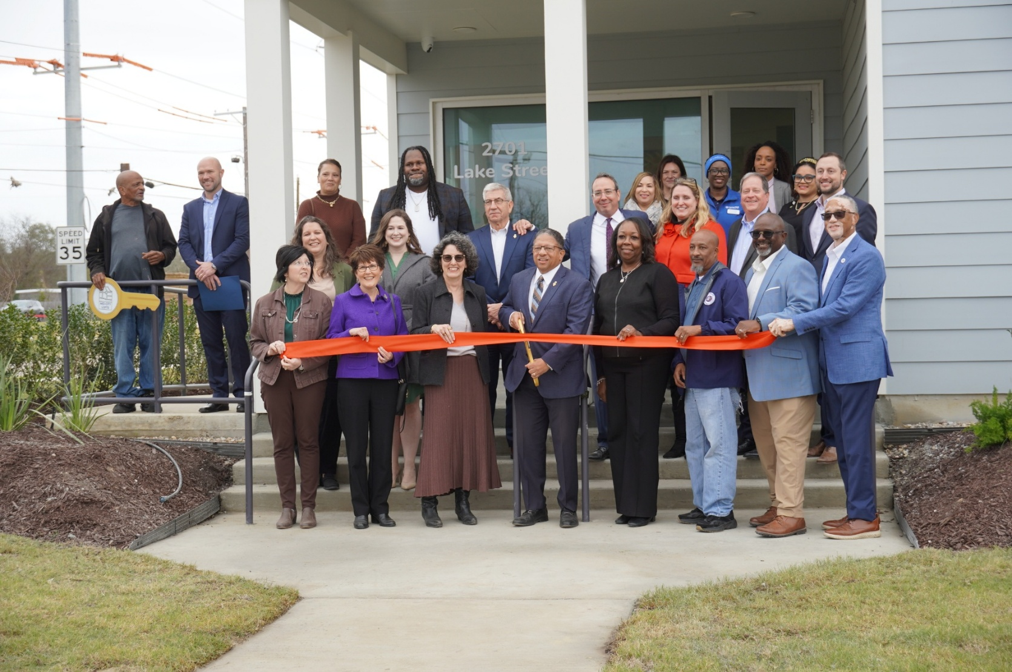
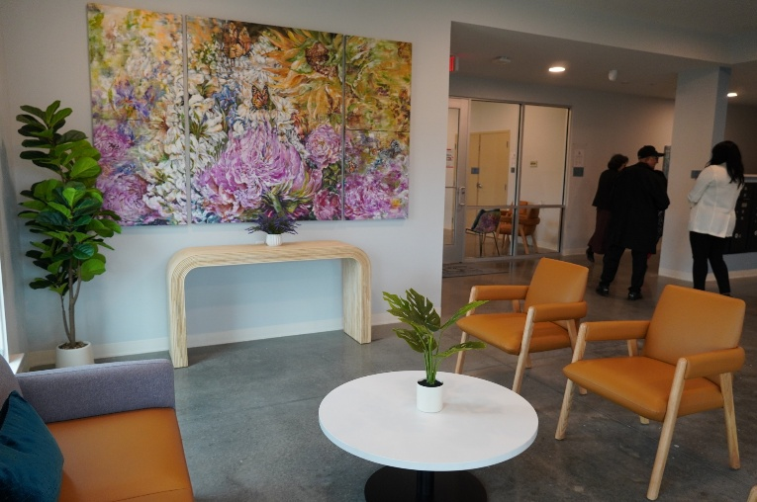
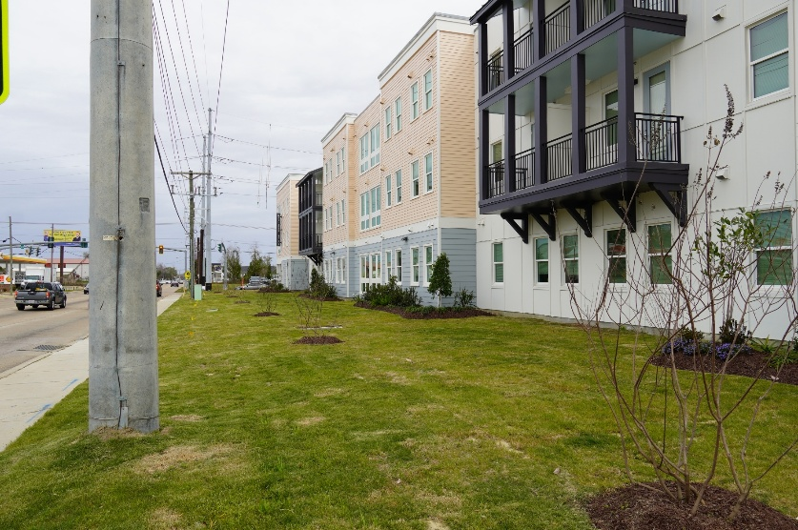
Ribbon Cutting for the Mid-City Lofts
Notes:
LHC also celebrated the grand opening of the Mid-City Lofts in Lake Charles, LA. The Mid-City Lofts includes 46 units within a 3-story building for mixed-income tenants. The building utilizes Enterprise Green Communities resiliency standards. Other amenities featured in the project are a computer lab, 24/7 emergency maintenance staffing, and a fitness center. Mid-City Lofts received an allocation of $1.5M in 9% Low-Income Housing Tax Credits (LIHTC) from LHC. The development also received $3.5 million through the PRIME-3 Program, a collaborative funding source from LHC and the Louisiana Office of Community Development.

Slide 4
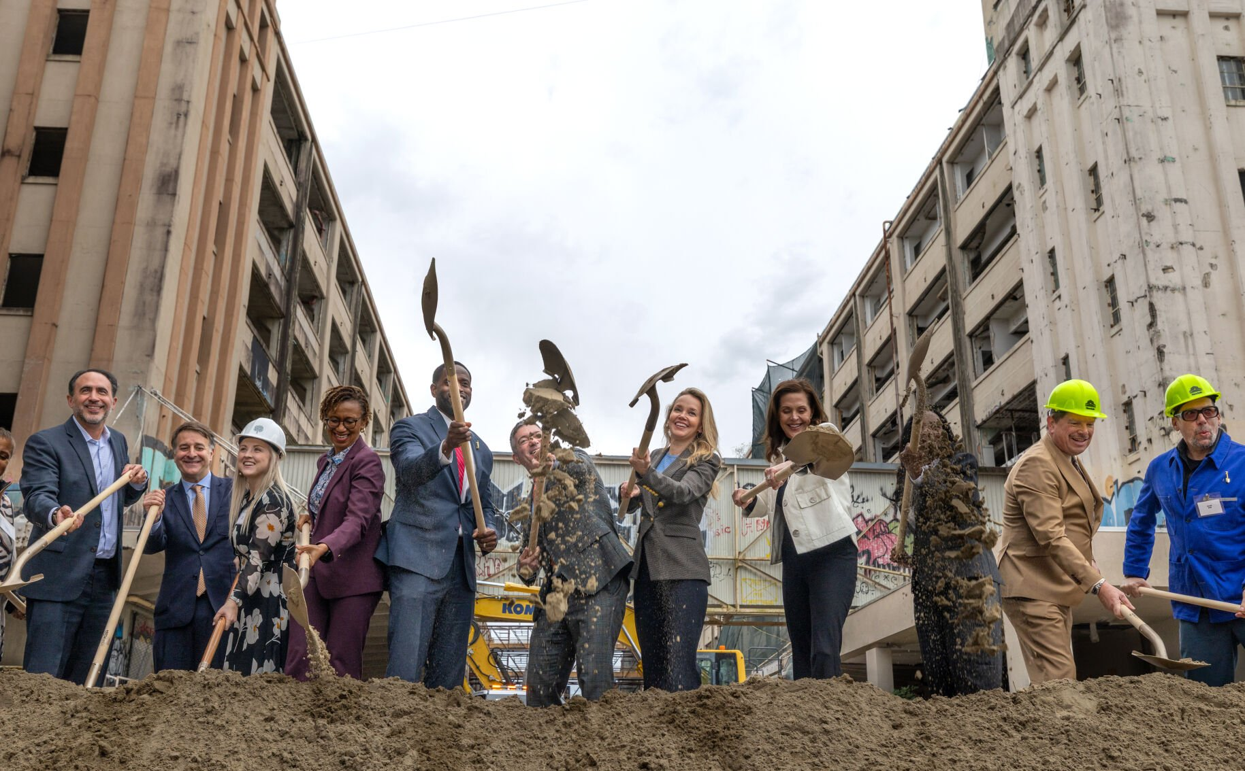
Groundbreaking of the NSA Complex
Notes:
LHC attended the groundbreaking ceremony for the Naval Support Activity Complex in New Orleans. This project will be an affordable housing and mixed-use development. This multi-phase redevelopment will transform a long-dormant federal site into a vibrant district for living, working, and pioneering innovation.

Slide 5
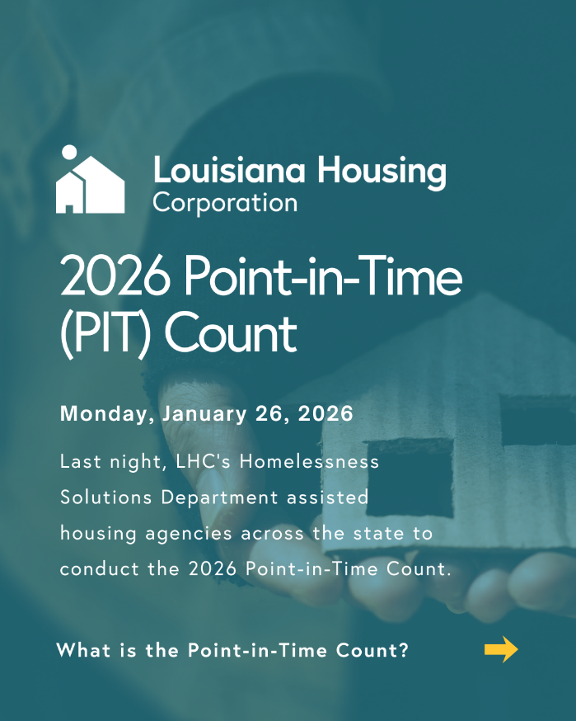
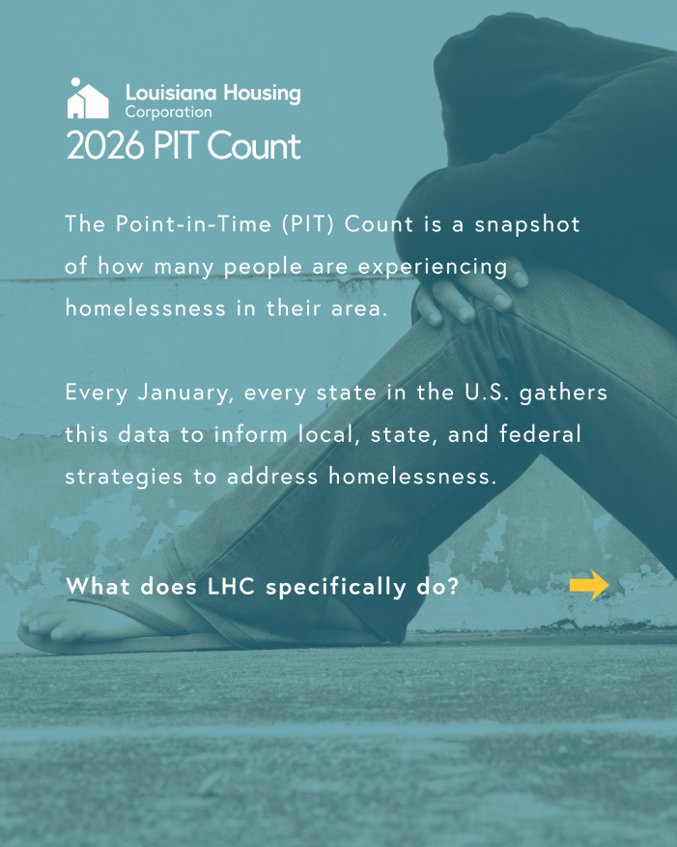
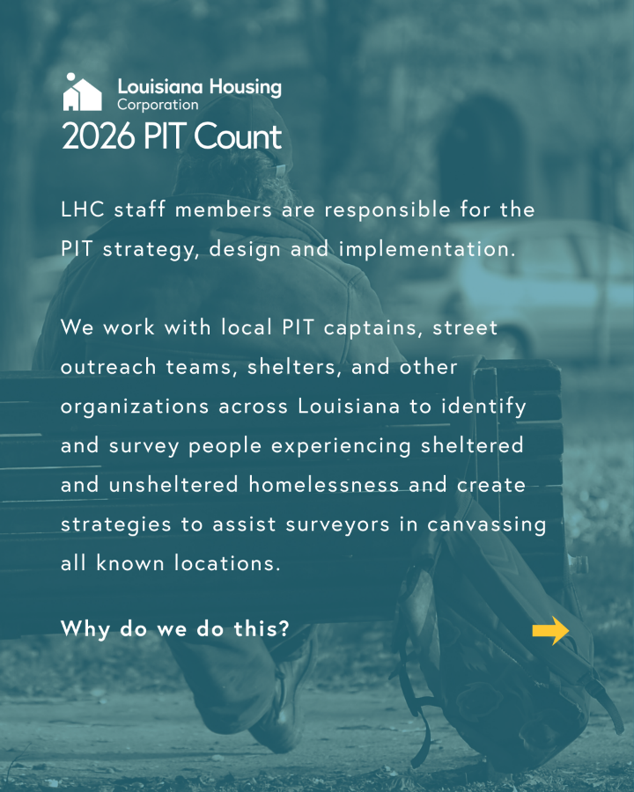
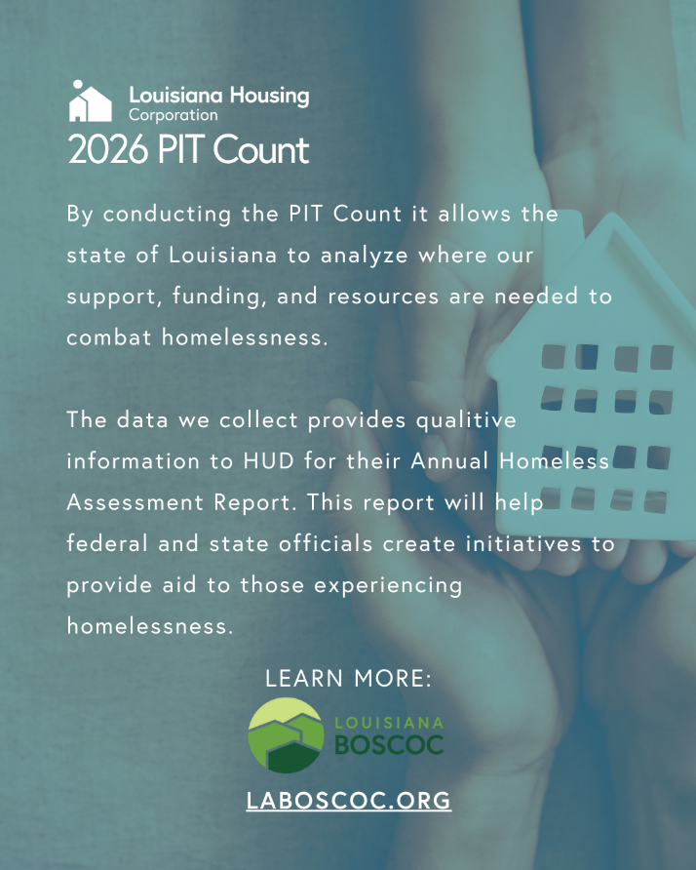
2026 Point-In-Time (PIT) COUNT
Notes:
I would like to say thank you to LHC’s Homelessness Solutions Department and the Louisiana Balance of State Continuum of Care for assisting our housing partners across the state in the 2026 Point-in-Time Count. They did this count when the majority of our state remained in the arctic blast, and we appreciate their endeavors in helping us get vital details regarding our homeless population in Louisiana.

